Slide 1
McGill Competitive programming
-Graph theory part 2
Andre Kaba

Slide 2
Topics today:
Shortest paths
Minimum spanning trees
We will solve 4 interesting problems

Slide 3
Shortest paths

Slide 4
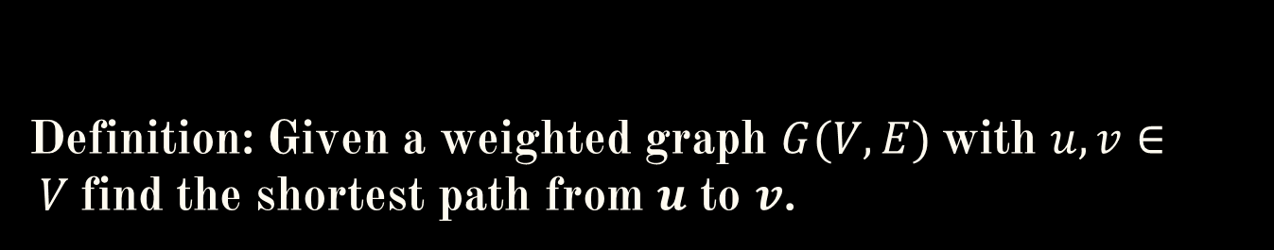
Definition: Given a weighted graph $G(V,E)$with $u,v∈ V$find the shortest path from $u$ to $v$.

Slide 5
Weights could represent distance between cities, cost of going from one vertex to another … etc.

Slide 6
We are going to cover 4 algorithms:
BFS
Dijkstra’s
Bellman-ford
Floyd-Warshall

Slide 7
BFS

Slide 8
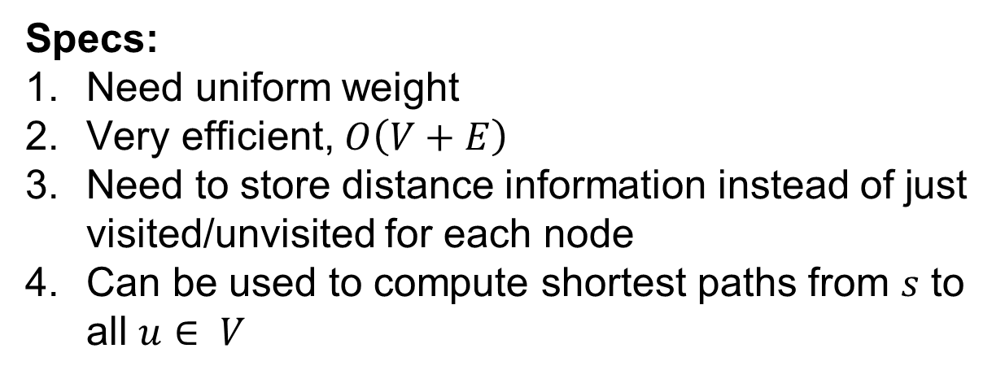
BFS
Specs:
Need uniform weight
Very efficient, $O\left(V+E\right)$
Need to store distance information instead of just visited/unvisited for each node
Can be used to compute shortest paths from $s$ to all $u∈ V$

Slide 9


Slide 10
Dijkstra’s

Slide 11
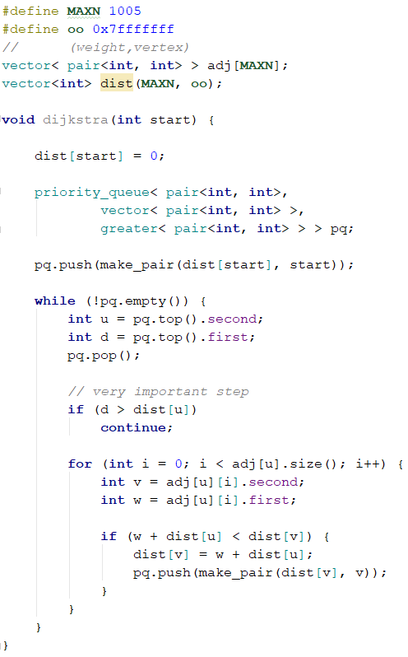
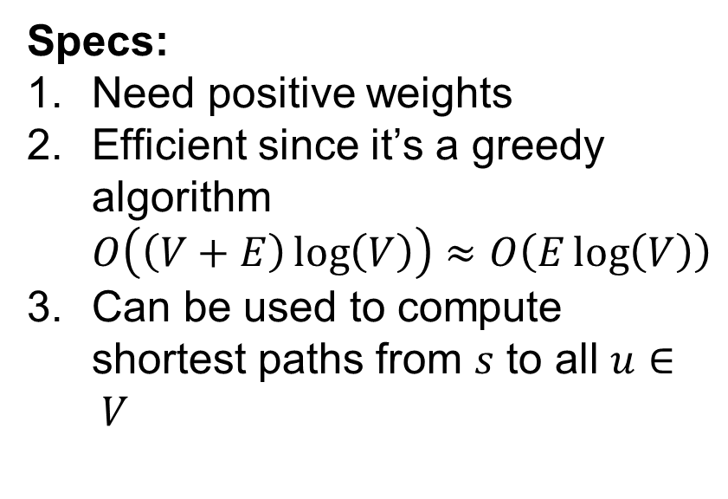
Dijkstra’s
Specs:
Need positive weights
Efficient since it’s a greedy algorithm $O\left(\left(V+E\right)\log\left(V\right)\right)≈O\left(E\log\left(V\right)\right)$
Can be used to compute shortest paths from $s$ to all $u∈ V$
Relaxation step

Slide 12
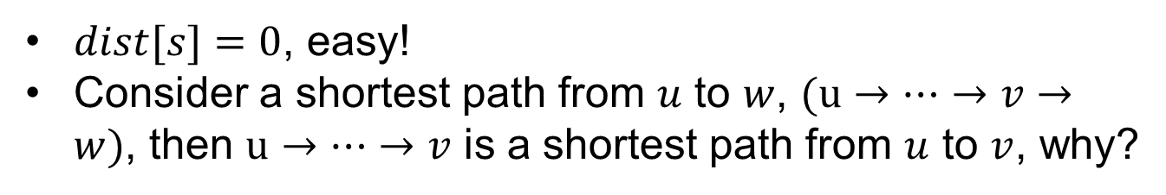
Proof intuition:
$dist[s]=0$, easy!
Consider a shortest path from $u$ to $w$, $(u→…→v→w)$, then $u→…→v$ is a shortest path from $u$ to $v$, why?
s
v
w

Slide 13
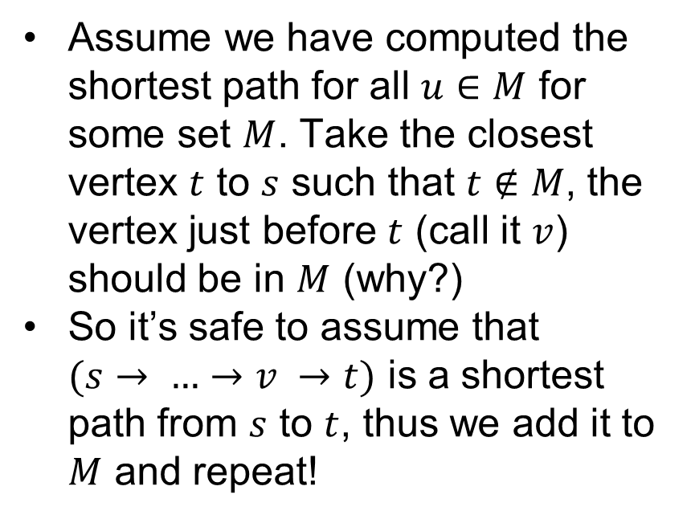
Proof intuition:
Assume we have computed the shortest path for all $u∈M$ for some set $M$. Take the closest vertex $t$ to $s$ such that $t∉M$, the vertex just before $t$ (call it $v$) should be in $M$ (why?)
So it’s safe to assume that $(s→ …→v →t)$ is a shortest path from $s$ to $t$, thus we add it to $M$ and repeat!

Slide 14













Proof intuition:
Assume we have computed the shortest path for all $u∈M$ for some set $M$. Take the closest vertex $t$ to $s$ such that $t∉M$, the vertex just before $t$ (call it $v$) should be in $M$ (why?)
So it’s safe to assume that $(s→ …→v →t)$ is a shortest path from $s$ to $t$, thus we add it to $M$ and repeat!
$$w_{3}$$
$$t$$
$$z$$
$$w_{1}$$
$$w_{2}$$
$$w′′$$
$$w′$$
$$b$$
$$a$$
$$v$$
$$s$$
$$M$$
Assume $w_{1}<w^{′′}<w′$

Slide 15
Proof intuition:
Assume we have computed the shortest path for all $u∈M$ for some set $M$. Take the closest vertex $t$ to $s$ such that $t∉M$, the vertex just before $t$ (call it $v$) should be in $M$ (why?)
So it’s safe to assume that $(s→ …→v →t)$ is a shortest path from $s$ to $t$, thus we add it to $M$ and repeat!
$$w_{3}$$
$$t$$
$$z$$
$$w_{1}$$
$$w_{2}$$
$$w′′$$
$$w′$$
$$b$$
$$a$$
$$v$$
$$s$$
$$M$$
Assume $w_{1}<w^{′′}<w′$
We cannot have $w_{3}+w_{2}<w_{1}$, since $w_{3}≥0$

Slide 16
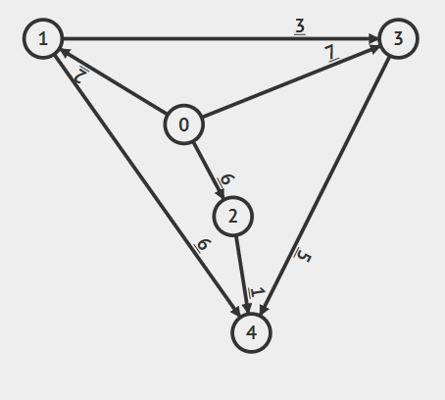
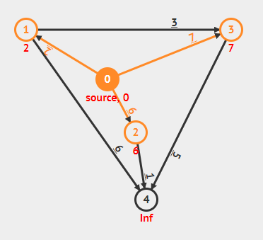
Example:

Slide 17
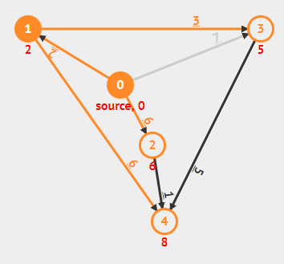
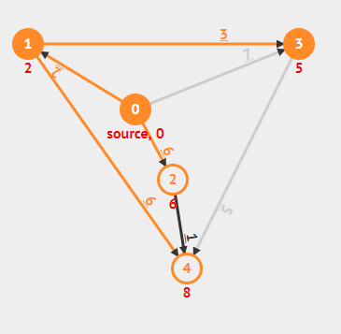
Example:

Slide 18
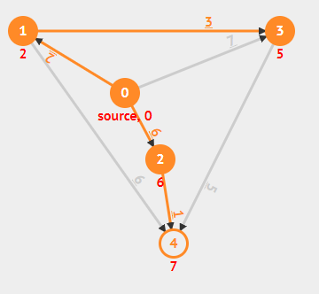
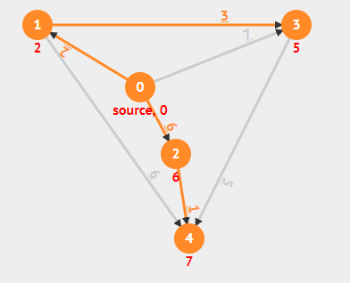
Example:

Slide 19
Final notes:
The edges included in the shortest paths always form a tree.
So we can compute the path itself using a parent array.
There exist a version that handles negative weights.

Slide 20
Bellman-ford

Slide 21
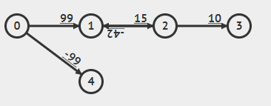
Problem with Dijkstra’s
What’s the shortest path from 0 to 2??

Slide 22
Problem with Dijkstra’s
Negative cycles!
What’s the shortest path from 0 to 2??

Slide 23
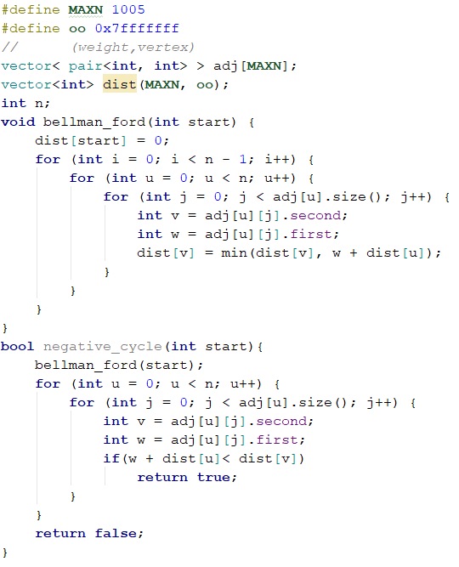
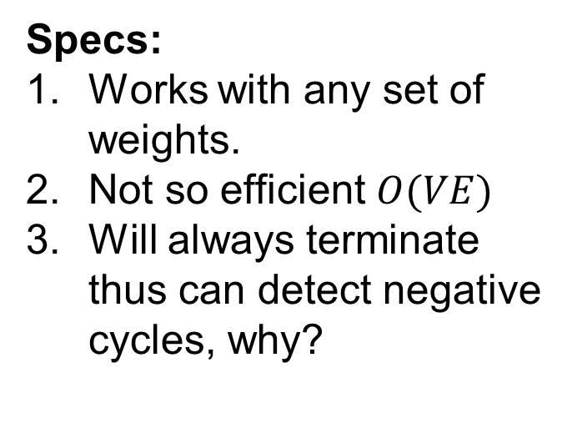
Bellman-ford
Specs:
Works with any set of weights.
Not so efficient $O(VE)$
Will always terminate thus can detect negative cycles, why?

Slide 24
Floyd-Warshall

Slide 25
What if we need all pairs shortest paths?
Run shortest path with all n sources?

Slide 26
What if we need all pairs shortest paths?
Run shortest path with all n sources?
Can we do better?

Slide 27
What if we need all pairs shortest paths?
Run shortest path with all n sources?
Can we do better?
Yes!

Slide 28


Slide 29
Floyd-Warshall
Specs:
Requires no positive cycles, negative weights are fine.
Uses DP to computer shortest paths.
Very easy to implement.
Not so efficient, but it computes all shortest paths!

Slide 30
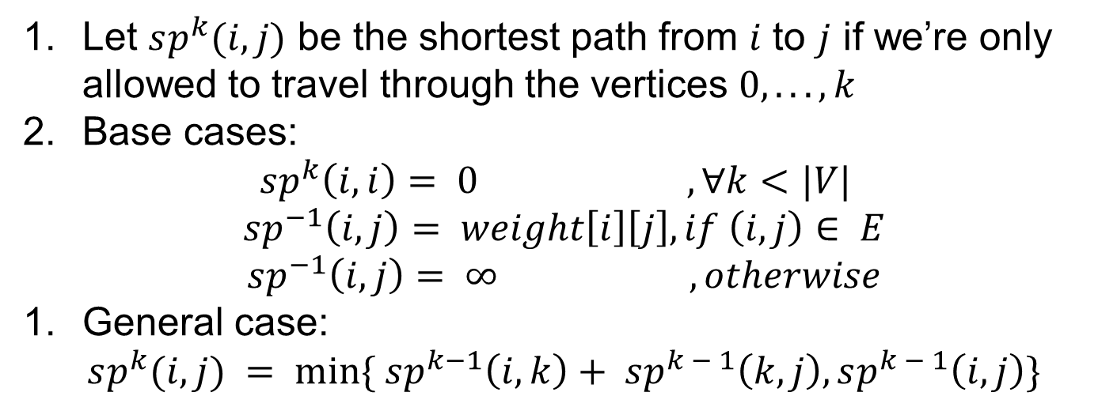
Intuition:
Let $sp^{k}(i, j)$ be the shortest path from $i$ to $j$ if we’re only allowed to travel through the vertices $0, . . . , k$
Base cases:
$$sp^{k}\left(i, i\right)= 0 , ∀k<|V|$$
$$sp^{−1}\left(i, j\right)= weight\left[i\right]\left[j\right], if \left(i, j\right)∈ E$$
$$sp^{−1}\left(i, j\right)= ∞ , otherwise$$
General case:
$$sp^{k}(i, j) = min⁡\{ sp^{k−1}\left(i, k\right)+ sp^{k − 1}\left(k, j\right),sp^{k − 1}\left(i, j\right)\}$$

Slide 31
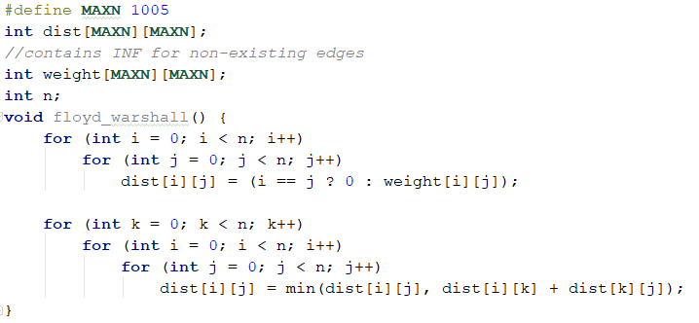
Code:

Slide 32
Minimum spanning tree

Slide 33
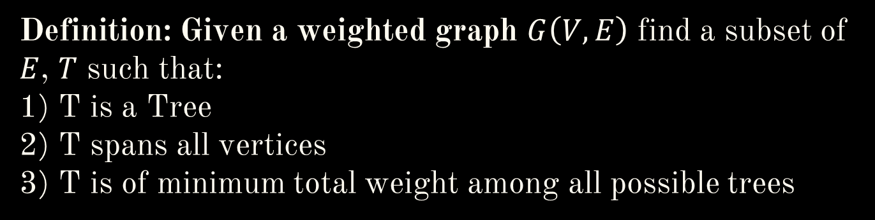
Definition: Given a weighted graph $G\left(V,E\right)$ find a subset of $E$, $T$ such that: 1) T is a Tree 2) T spans all vertices 3) T is of minimum total weight among all possible trees

Slide 34
There are 2 popular algorithms:
Kruskal’s (we will only cover this)
Prim’s

Slide 35
Kruskal’s

Slide 36
Kruskal’s
Idea:
Sort edges by weight and add them one by one as long as they don’t introduce cycles to maintain the tree property.
How to detect cycles efficiently?

Slide 37
Kruskal’s
Idea:
Sort edges by weight and add them one by one as long as they don’t introduce cycles to maintain the tree property.
How to detect cycles efficiently? Disjoint sets!

Slide 38
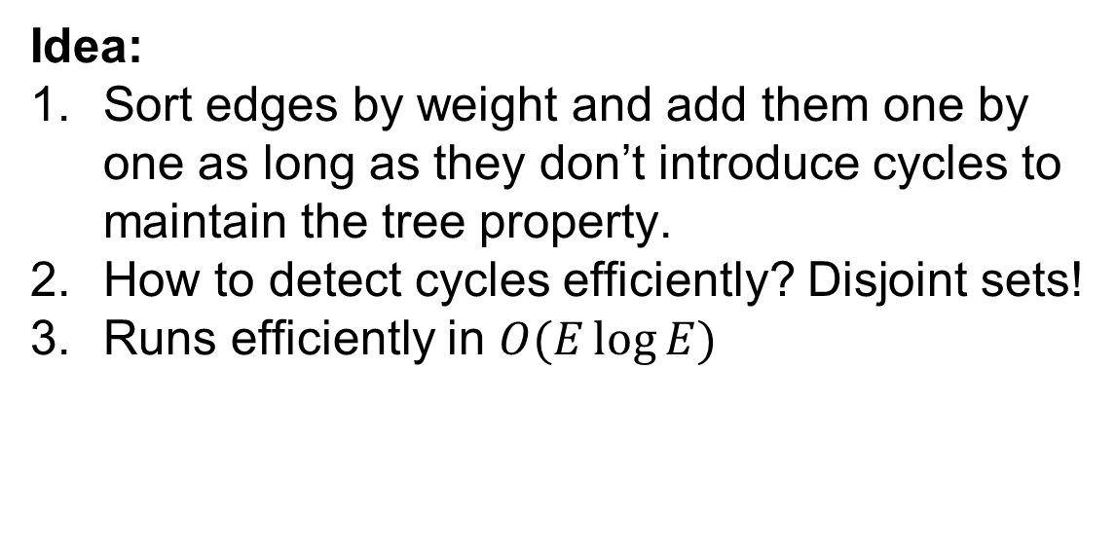
Kruskal’s
Idea:
Sort edges by weight and add them one by one as long as they don’t introduce cycles to maintain the tree property.
How to detect cycles efficiently? Disjoint sets!
Runs efficiently in $O(E\log{E})$

Slide 39
Intuition :
If we don’t take the minimum edge then we can use it later to replace a higher weight edge in some cycle to get a better spanning tree!
4
1
5
2
3

Slide 40
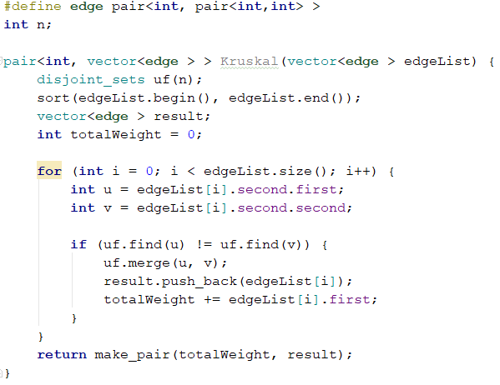
Code:

Slide 41
Problems

Slide 42
Starters Problems:
Dijkstra | Kruskal | BFS | Floyd-Warshall
https://www.hackerrank.com/challenges/dijkstrashortreach/problem | https://www.hackerrank.com/challenges/kruskalmstrsub/problem | https://www.hackerrank.com/challenges/bfsshortreach/problem | https://www.hackerrank.com/challenges/floyd-city-of-blinding-lights/problem

Slide 43
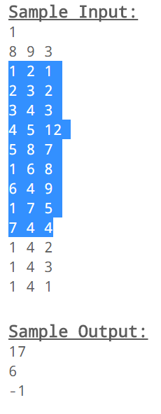
1. Increasing Shortest Path
You are given a directed graph G with distinct positive weights and bunch of queries. Each query will be represented by 3 integers A B C, which means you need to find the shortest path from A to B that uses at most C edges, such that the weights of the edges in that path are in increasing order along the path.
2
3
1
2
3
1
12
8
9
4
5
6
7
5
4
8
7
Source: https://a2oj.com/p?ID=4

Slide 44
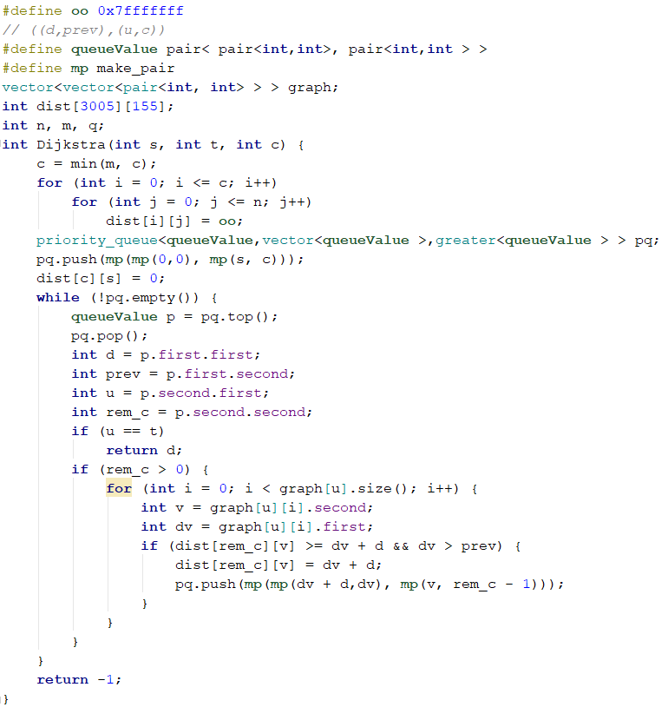
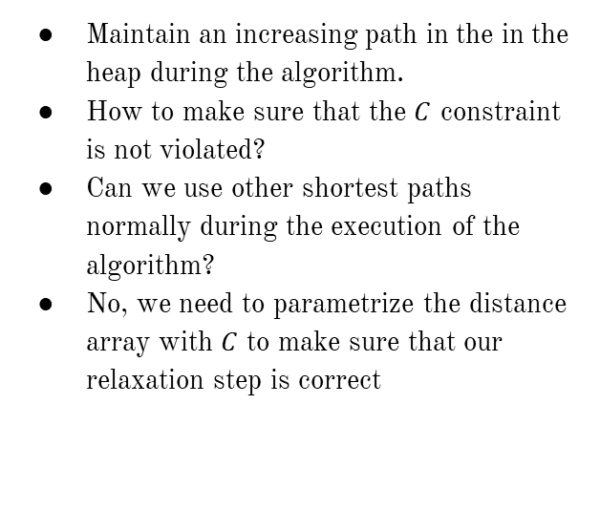
Idea
Maintain an increasing path in the in the heap during the algorithm.
How to make sure that the $C$ constraint is not violated?
Can we use other shortest paths normally during the execution of the algorithm?
No, we need to parametrize the distance array with $C$ to make sure that our relaxation step is correct

Slide 45
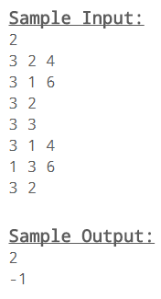
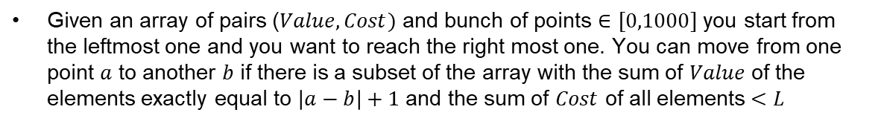
2. Mario Kart
Given an array of pairs ($Value,Cost)$ and bunch of points $∈[0,1000]$ you start from the leftmost one and you want to reach the right most one. You can move from one point $a$ to another $b$ if there is a subset of the array with the sum of $Value$ of the elements exactly equal to $\left|a−b\right|+1$ and the sum of $Cost$ of all elements $<L$
1 | 2 | 3 | 4 | 5 | 6
Cost Value
3 | 2
3 | 3
X |  | X |  |  | X
1 | 2 | 3 | 4 | 5 | 6
Cost Value
X |  | X |  |  | X
3 | 2
Source: https://a2oj.com/p?ID=12

Slide 46
Mario Kart
1 | 2 | 3 | 4 | 5 | 6
Cost Value
3 | 2
3 | 3
X |  | X |  |  | X
How do we build the graph? Hint: remember our DP trick for subset sum
What do we do after? Run BFS!
Source: https://a2oj.com/p?ID=12

Slide 47
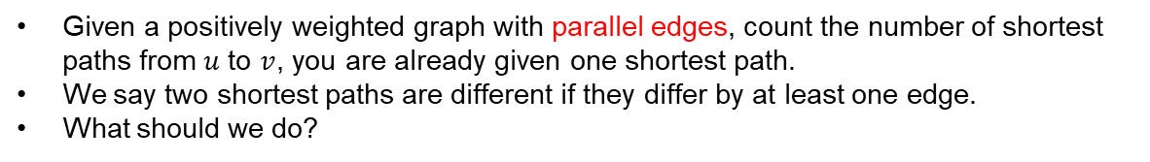
3. Change of scenery
Given a positively weighted graph with parallel edges, count the number of shortest paths from $u$ to $v$, you are already given one shortest path.
We say two shortest paths are different if they differ by at least one edge.
What should we do?
Source: (GCPC 2015) http://codeforces.com/gym/100753/attachments

Slide 48
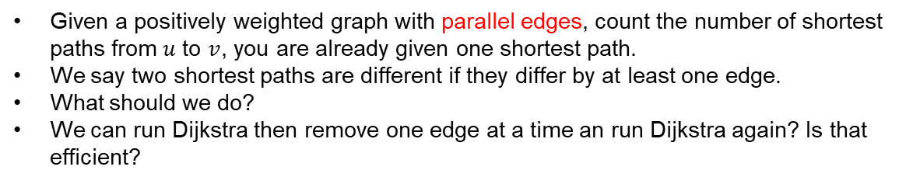
Change of scenery
Given a positively weighted graph with parallel edges, count the number of shortest paths from $u$ to $v$, you are already given one shortest path.
We say two shortest paths are different if they differ by at least one edge.
What should we do?
We can run Dijkstra then remove one edge at a time an run Dijkstra again? Is that efficient?
Source: (GCPC 2015) http://codeforces.com/gym/100753/attachments

Slide 49
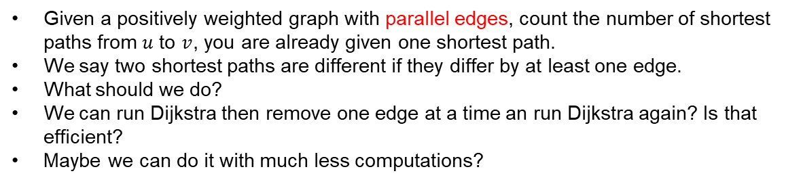
Change of scenery
Given a positively weighted graph with parallel edges, count the number of shortest paths from $u$ to $v$, you are already given one shortest path.
We say two shortest paths are different if they differ by at least one edge.
What should we do?
We can run Dijkstra then remove one edge at a time an run Dijkstra again? Is that efficient?
Maybe we can do it with much less computations?
Source: (GCPC 2015) http://codeforces.com/gym/100753/attachments

Slide 50
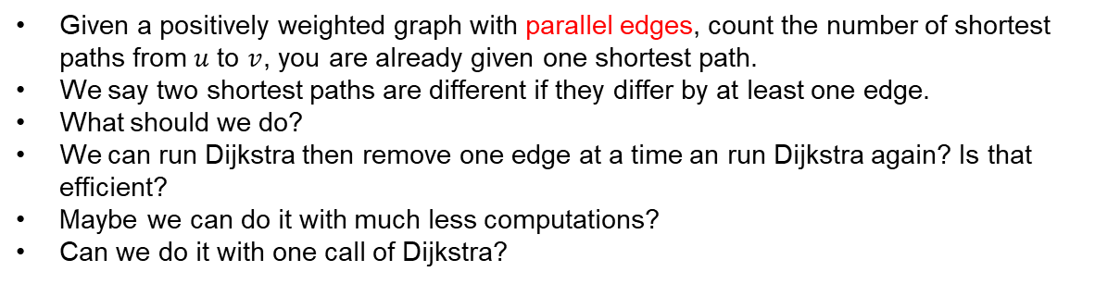
Change of scenery
Given a positively weighted graph with parallel edges, count the number of shortest paths from $u$ to $v$, you are already given one shortest path.
We say two shortest paths are different if they differ by at least one edge.
What should we do?
We can run Dijkstra then remove one edge at a time an run Dijkstra again? Is that efficient?
Maybe we can do it with much less computations?
Can we do it with one call of Dijkstra?
Source: (GCPC 2015) http://codeforces.com/gym/100753/attachments

Slide 51
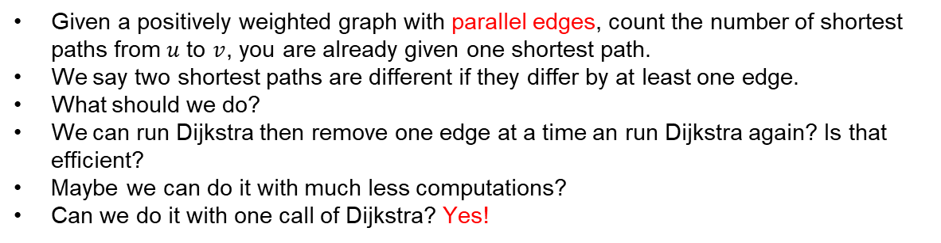
Change of scenery
Given a positively weighted graph with parallel edges, count the number of shortest paths from $u$ to $v$, you are already given one shortest path.
We say two shortest paths are different if they differ by at least one edge.
What should we do?
We can run Dijkstra then remove one edge at a time an run Dijkstra again? Is that efficient?
Maybe we can do it with much less computations?
Can we do it with one call of Dijkstra? Yes!
Source: (GCPC 2015) http://codeforces.com/gym/100753/attachments

Slide 52
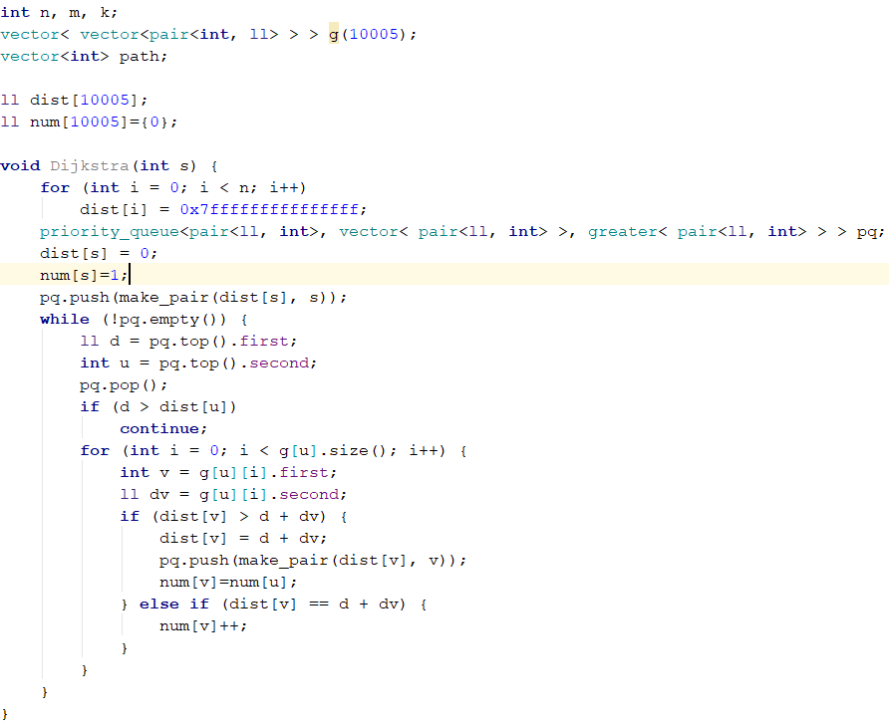
Solution

Slide 53
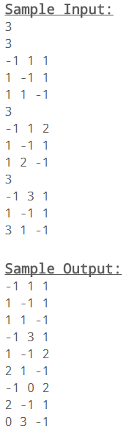
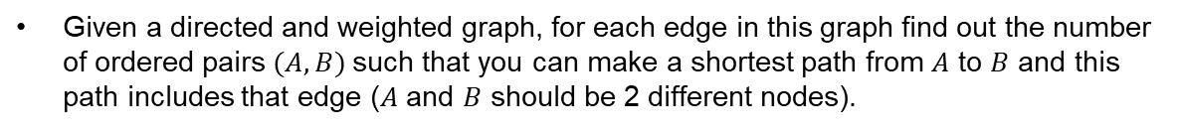
4. Best Edges
Given a directed and weighted graph, for each edge in this graph find out the number of ordered pairs $(A, B)$such that you can make a shortest path from $A$ to $B$ and this path includes that edge ($A$ and $B$ should be 2 different nodes).
1
1
2
1
1
1
1
1
3
Source: https://a2oj.com/p?ID=207

Slide 54
4. Best Edges
Given a directed and weighted graph, for each edge in this graph find out the number of ordered pairs $(A, B)$such that you can make a shortest path from $A$ to $B$ and this path includes that edge ($A$ and $B$ should be 2 different nodes).
1
1
1
2
1
2
1
1
1
1
2
1
1
1
1
2
3
3
Source: https://a2oj.com/p?ID=207

Slide 55
4. Best Edges
Given a directed and weighted graph, for each edge in this graph find out the number of ordered pairs $(A, B)$such that you can make a shortest path from $A$ to $B$ and this path includes that edge ($A$ and $B$ should be 2 different nodes).
1
1
3
1
2
1
2
1
2
1
1
1
1
1
2
1
1
1
1
1
1
2
3
1
3
3
3
Source: https://a2oj.com/p?ID=207

Slide 56
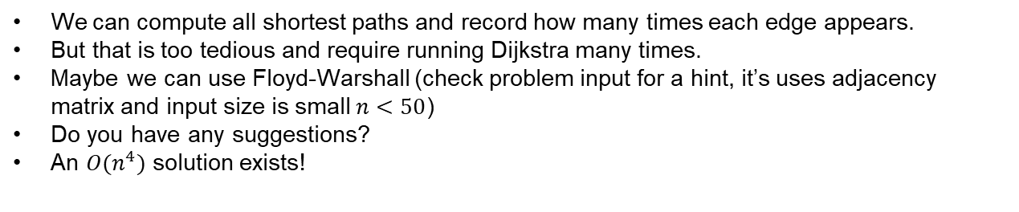
Idea
We can compute all shortest paths and record how many times each edge appears.
But that is too tedious and require running Dijkstra many times.
Maybe we can use Floyd-Warshall (check problem input for a hint, it’s uses adjacency matrix and input size is small $n<50$)
Do you have any suggestions?
An $O(n^{4})$ solution exists!

Slide 57

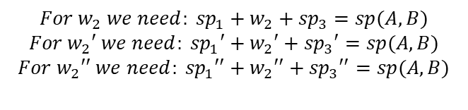
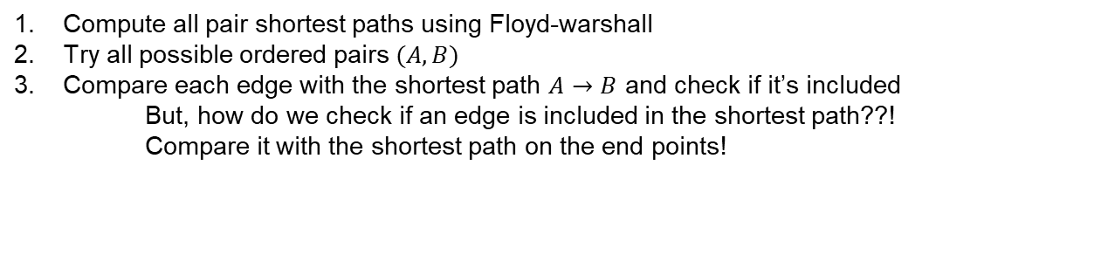








Efficient approach
Compute all pair shortest paths using Floyd-warshall
Try all possible ordered pairs $(A,B)$
Compare each edge with the shortest path $A→B$ and check if it’s included
But, how do we check if an edge is included in the shortest path??!
Compare it with the shortest path on the end points!
$$w_{2}$$
$${sp}_{3}$$
$${sp}_{1}$$
1
2
$$For w_{2} we need: {sp}_{1}+w_{2}+{sp}_{3}=sp(A,B)$$
$$For w_{2}′ we need: {sp}_{1}′+w_{2}′+{sp}_{3}′=sp(A,B)$$
$$For w_{2}′′ we need: {sp}_{1}′′+w_{2}′′+{sp}_{3}′′=sp(A,B)$$
A
$${sp}_{1}′$$
$$w_{2}′$$
$${sp}_{3}′$$
B
3
4
$${sp}_{1}′′$$
$$w_{2}′′$$
$${sp}_{3}′′$$
…
5
6
…

Slide 58
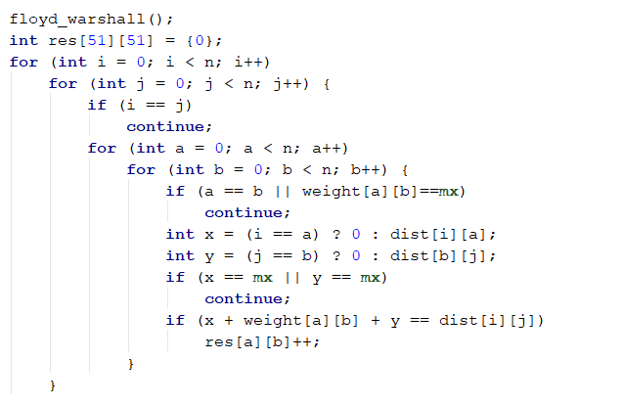
Solution

Slide 59
Hope you had fun
Thank you!

